Slide 1


RISC-V & HPC
Guided by :
Mr. Surendra Billa Sir
Mr. Rushikesh Jadhav Sir
Project P5:
Mr. Tejas Bhanudas Katkar PRN-230940130035
Mr. Bhanu Prakash Agrawal PRN-230940130015
Ms. Muskan Sharma PRN-230940130037
Ms. Akanksha Abhay Ghorpade PRN-230940130025

Slide 2
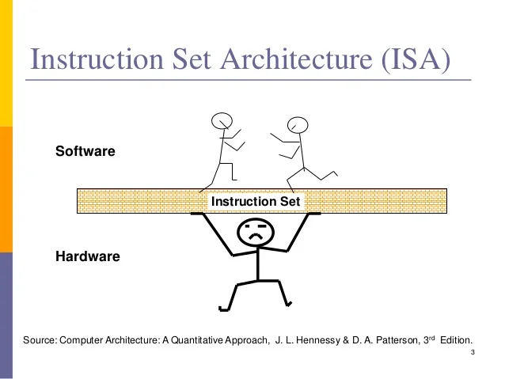
Instruction Set Architecture
Software
Hardware

Slide 3
Why RISC-V ?

Slide 4
ARM vs RISC V : ISA Comparison
ISAs can be broadly categorized into two types:
1→Open ISA
2→Closed ISA
Closed ISAs, like ARM, are proprietary and tightly controlled by specific companies (Arm Holdings here), offering established reliability and compatibility but limiting customization.
Open ISAs, exemplified by RISC-V, are community-driven and provide greater flexibility for customization, fostering innovation and adaptation to specific needs.

Slide 5
3 main advantages of RISC-V
Visibility
Flexibility
Control

Slide 6
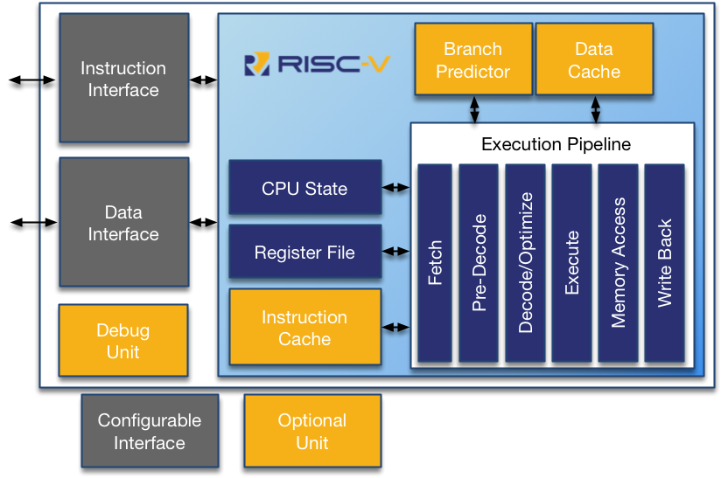
Risc-V Architecture

Slide 7
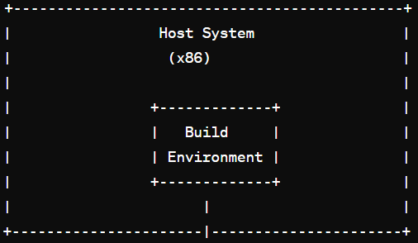
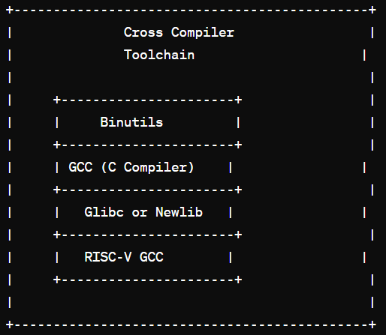
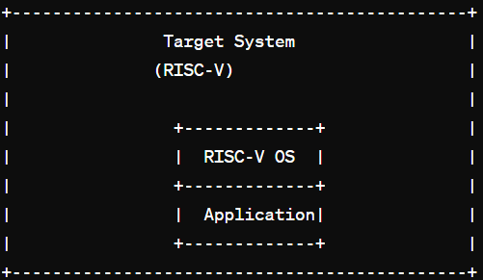
Cross Compiler Toolchain (Flow)

Slide 8
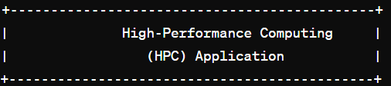
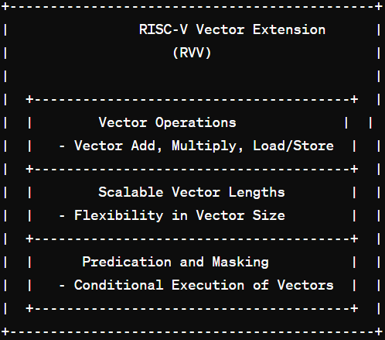
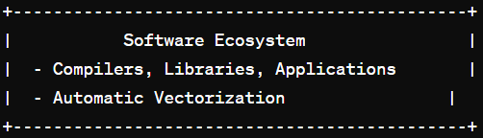
Vector Processing in HPC

Slide 9


Slide 10
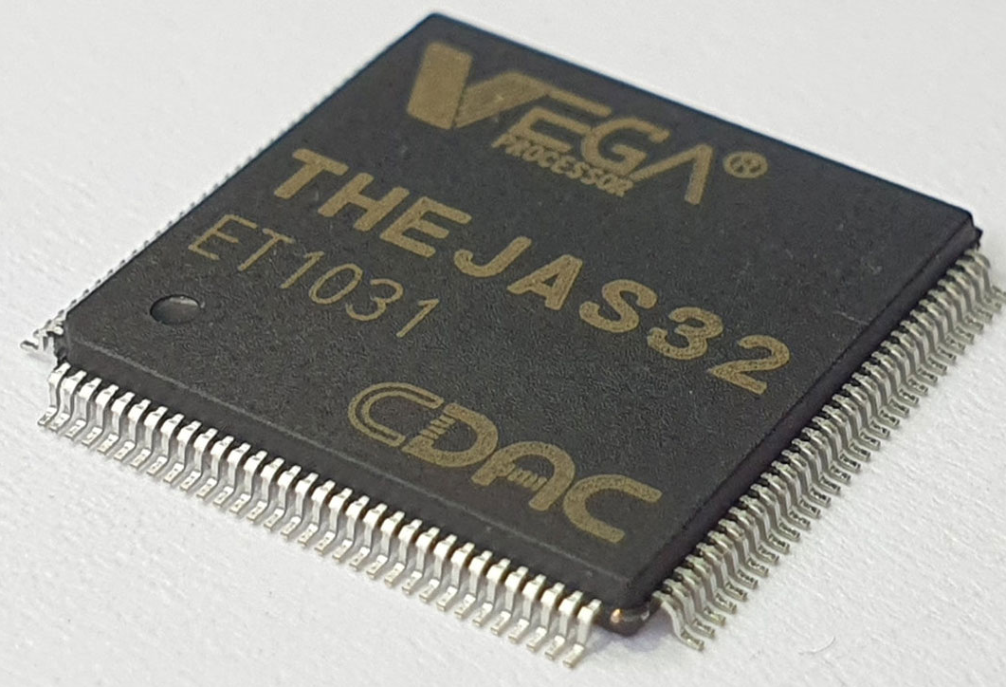
THEJAS32 SoC
THEJAS32 SoC is based on the VEGA ET1031 processor, which is a 32 bit single core in-order, 3-stage pipeline processor. This processor is based on the open source RISC-V Instruction Set Architecture and operates at a frequency of 100MHz. The SoC also includes peripherals like 256KB internal SRAM, Three UARTs, Four SPIs, Three TIMERs, Eight PWMs, Three I2C interfaces, 32 GPIOs etc. This SoC is designed and developed by Centre for Development of Advanced Computing (C-DAC) as part of the Digital India RISC-V (DIR-V) Program, by the Ministry of Electronics and Information Technology, Government of India.

Slide 11
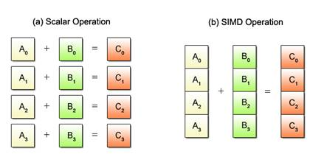
SIMD : Single instruction Multiple Data
How SIMD Operates ?

Slide 12
Vector Processing
Vector Processing Architecture
Memory to Memory Architecture (Traditional)
Register to Register Architecture (Modern)
Components of vector processors
Vector Registers
Vector functional Units
Vector load-store Units
Scalar Registers
Advantages of Vector processing
Quick fetch and decode of single instruction for multiple operations
Easier Addressing of main memory
Elimination of memory Wastage
Simplification of control hazards
Reduced code size

Slide 13
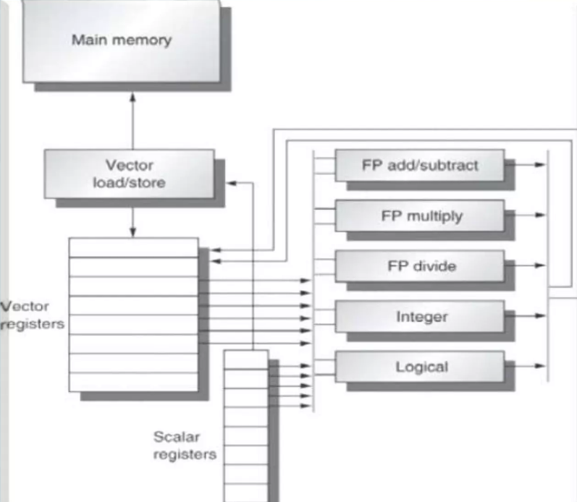

Slide 14
RISC-V V/S RISC-V V
Risc-v
–Base instruction Set Architecture
–Focuses in Scalar Operations
–Handles individually data elements
–Performance is less as compared to RVV
–Easy to understand
–Widely Adopted
Risc-v v
–Optional extension adds capabilities of SIMD
–Focuses on Vector Operations
–Handles multiple data elements
–Designed to work on large data sets
–High Performance
–RVV support is growing but not universally implemented on all all Risc-v

Slide 15

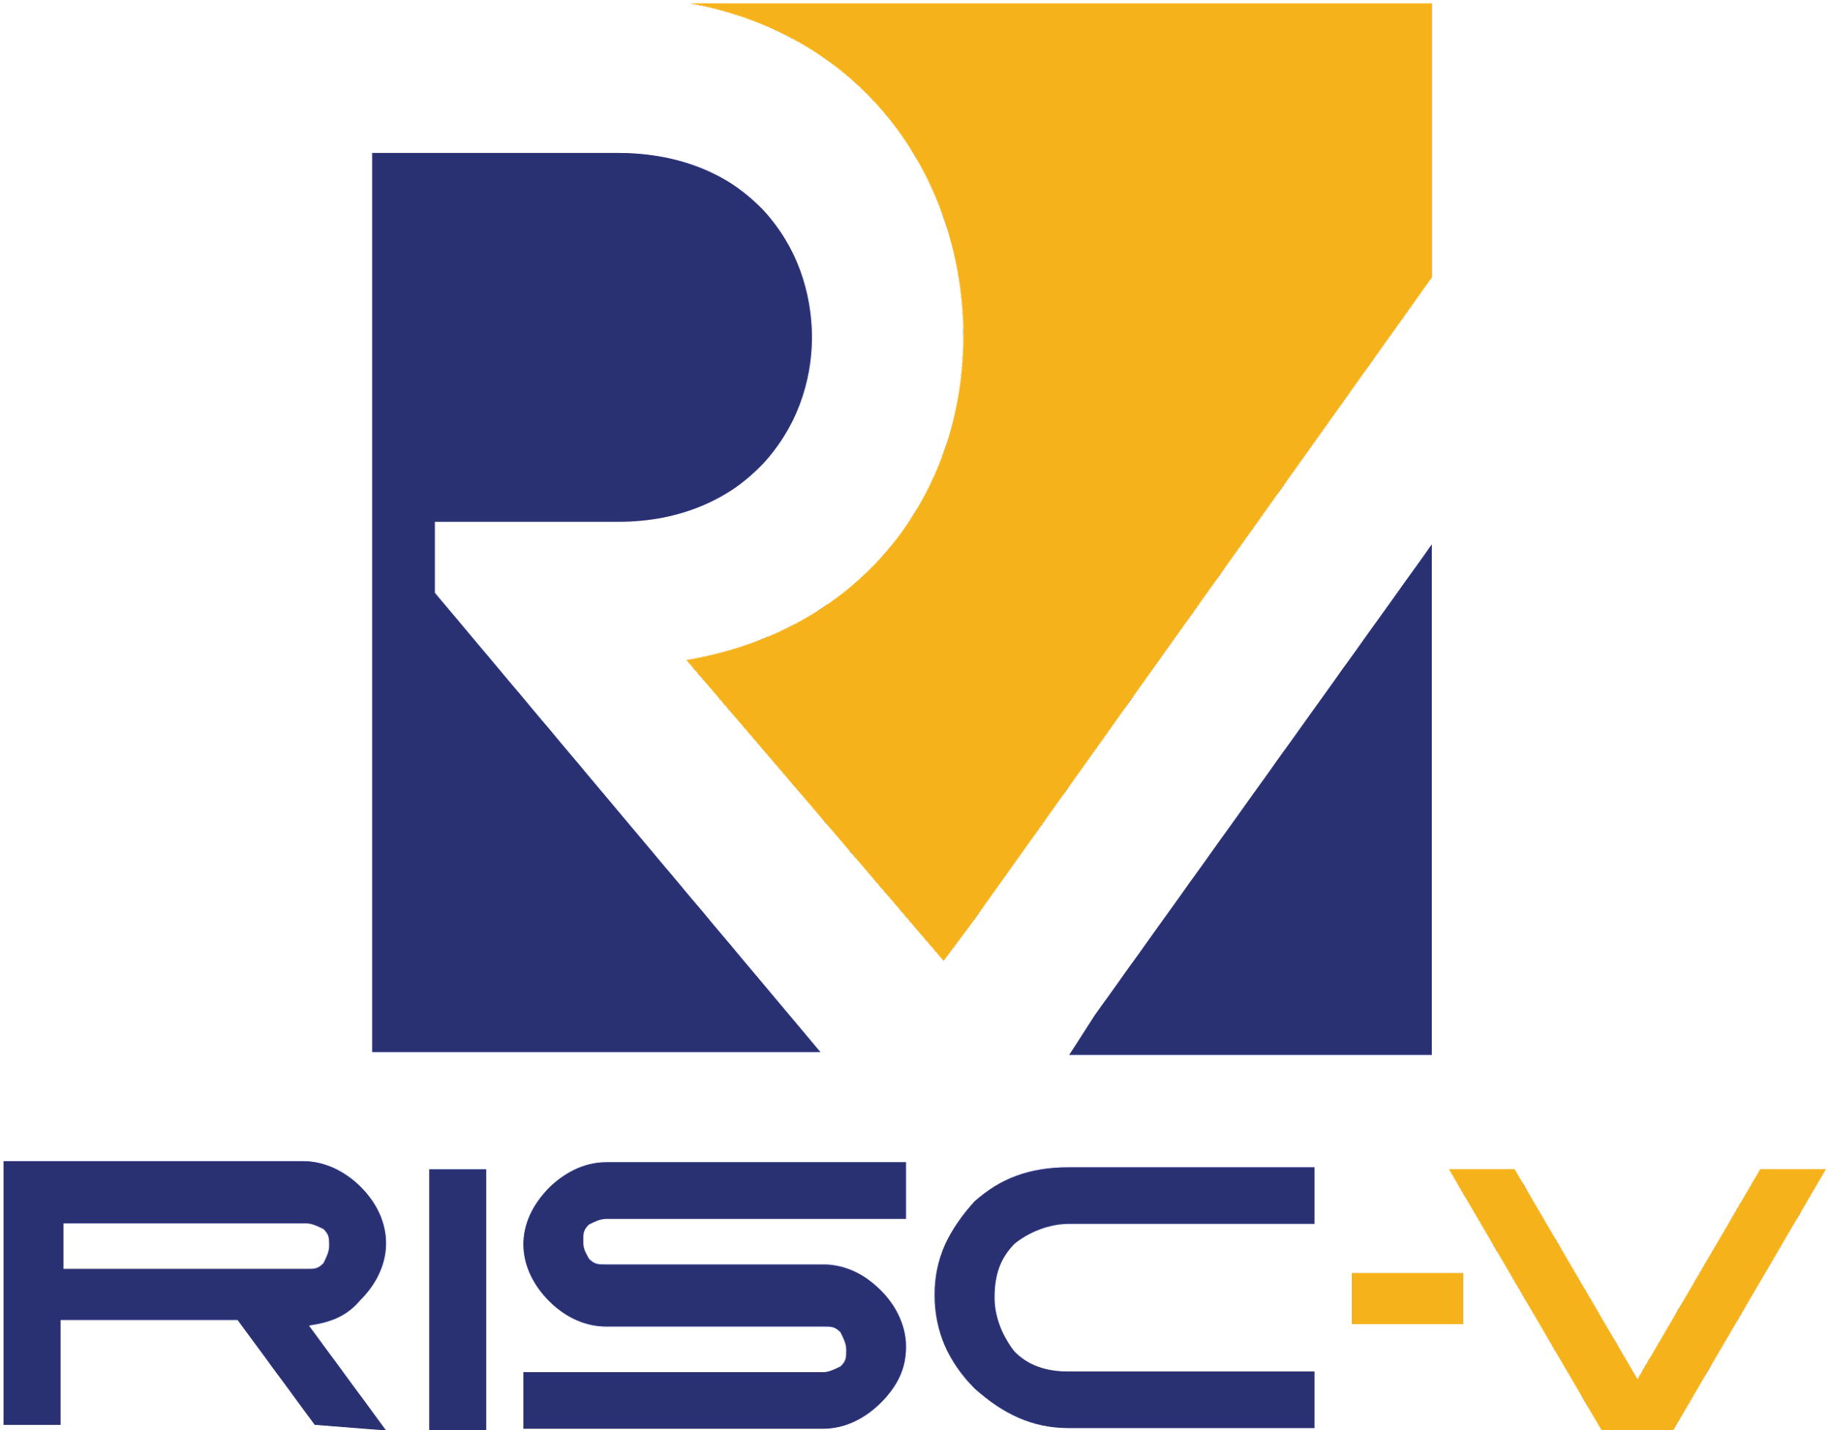
RISC-V VECTOR EXTENSION
Unleashing Parallelism in RISC-V Architecture

Slide 16
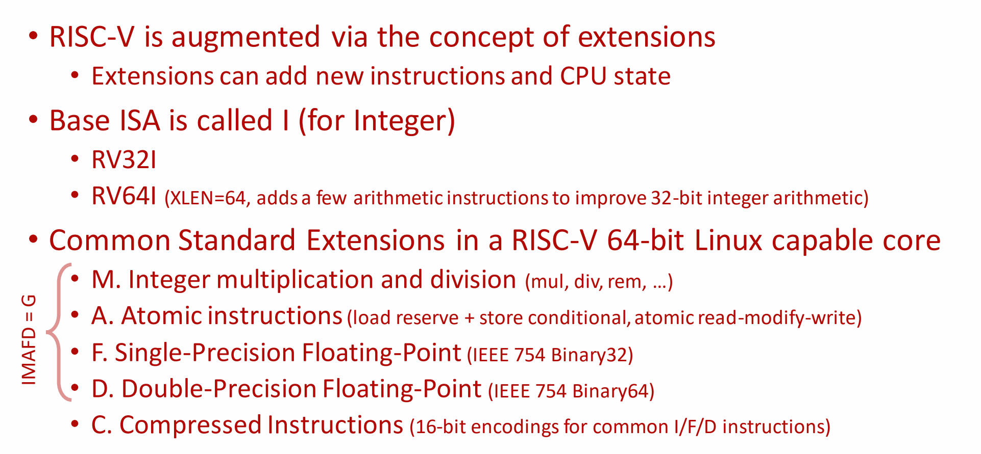
RISC-V EXTENSIONS

Slide 17
INTRODUCTION
What it is: A set of instructions for RISC-V processors that enable them to perform vector operations.
What it does: Allows processing multiple data elements at once, leading to faster performance for specific tasks.
When it's useful: For tasks involving large amounts of data and repetitive calculations, such as:
Signal processing
Image and video processing
Machine learning
Scientific computing

Slide 18
OVERVIEW OF ITS FEATURES AND CAPABILITIES
SIMD (Single Instruction, Multiple Data): Allows a single instruction to perform the same operation on multiple data elements simultaneously, exploiting data-level parallelism.
Enhanced Performance: By processing multiple data elements in parallel, the Vector Extension significantly improves throughput and efficiency for tasks such as multimedia processing, scientific computing, and machine learning.
Customizable Vector Length: Supports vectors of variable lengths, enabling optimization for different applications and target platforms.
Vector Registers: Dedicated vector registers hold vector data, facilitating efficient manipulation and computation.
Vector Memory Accesses: Supports efficient vector memory accesses, reducing overhead in loading and storing vector data.
Predication Support: Enables conditional execution based on vector elements, enhancing flexibility in control flow.

Slide 19
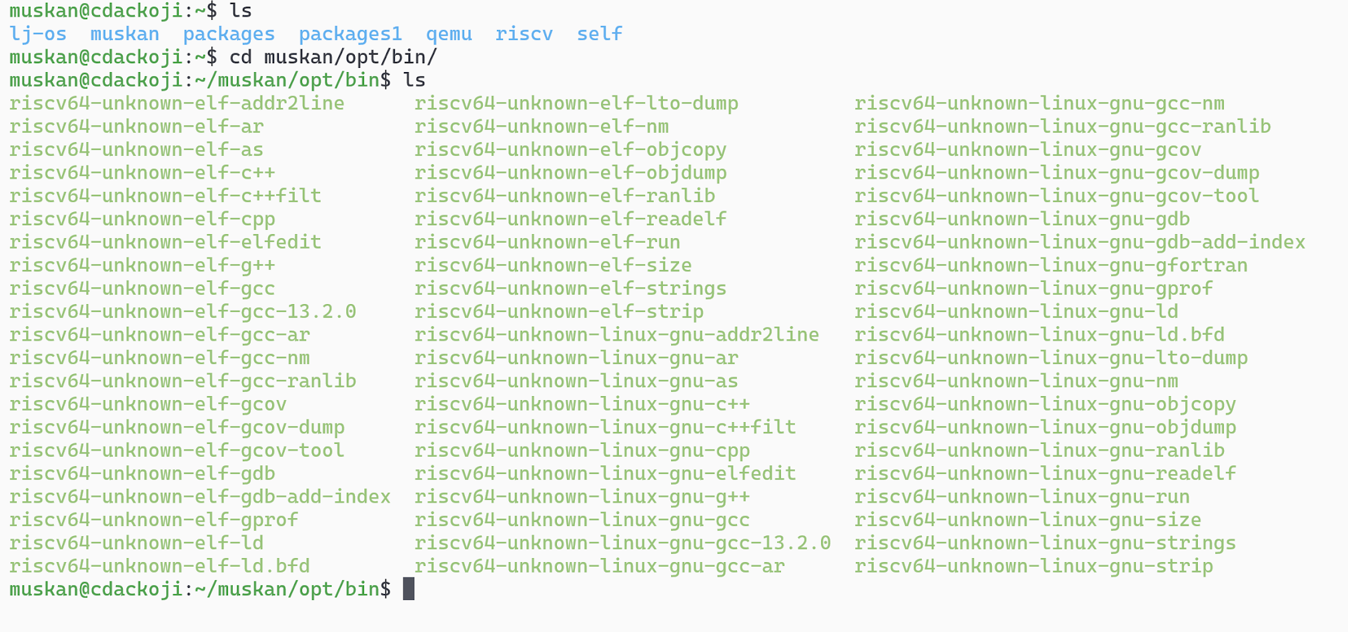
RISC-V RV64GV TOOLCHAIN

Slide 20
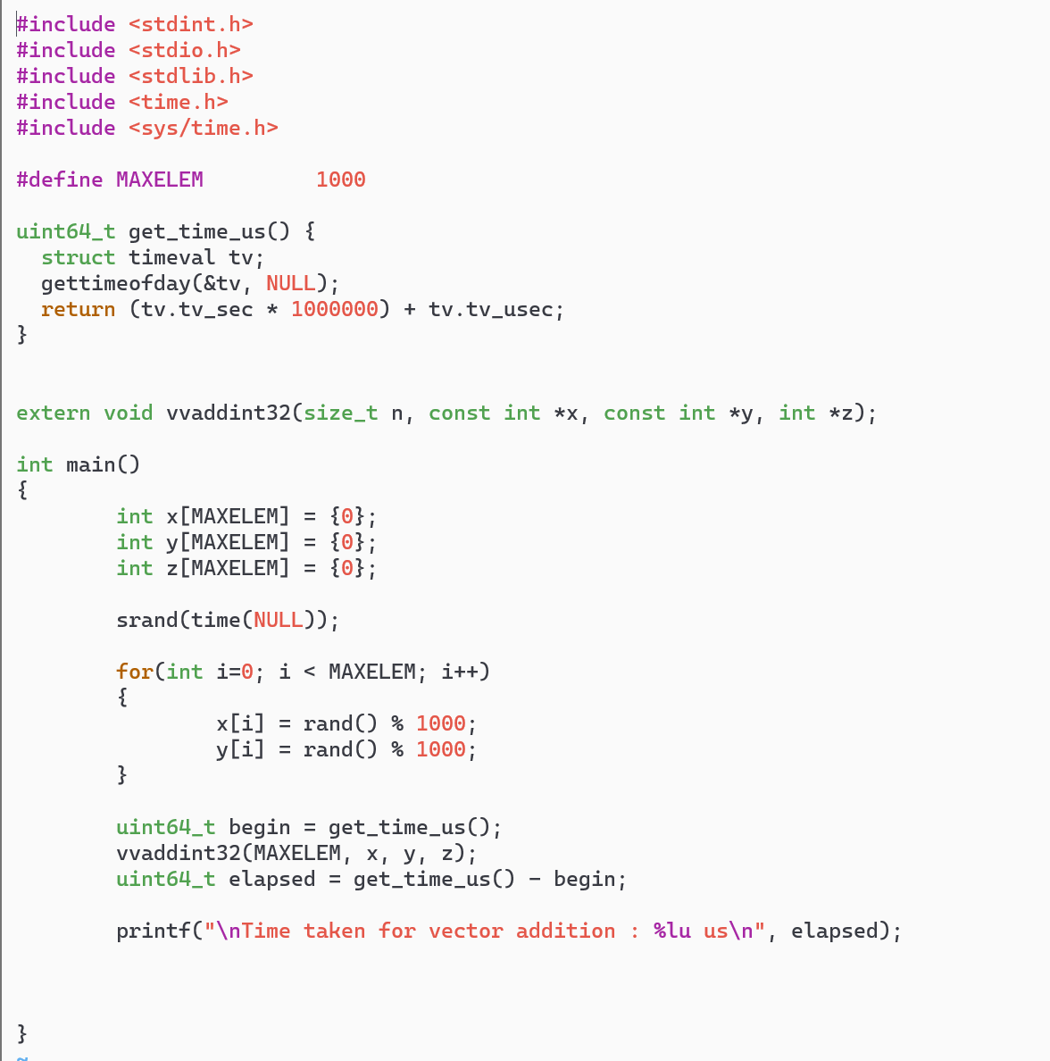
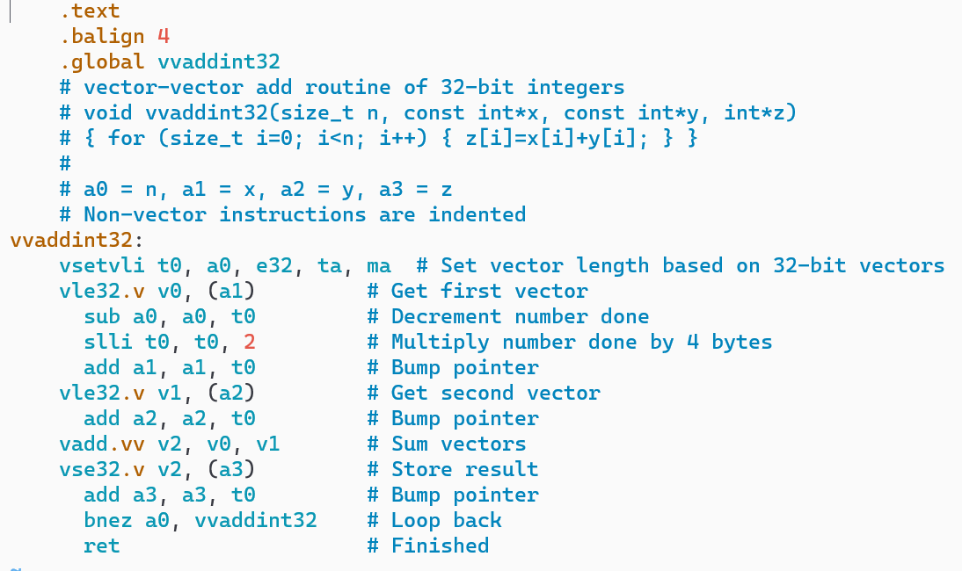
RISC-V VECTOR INSTRUCTION

Slide 21
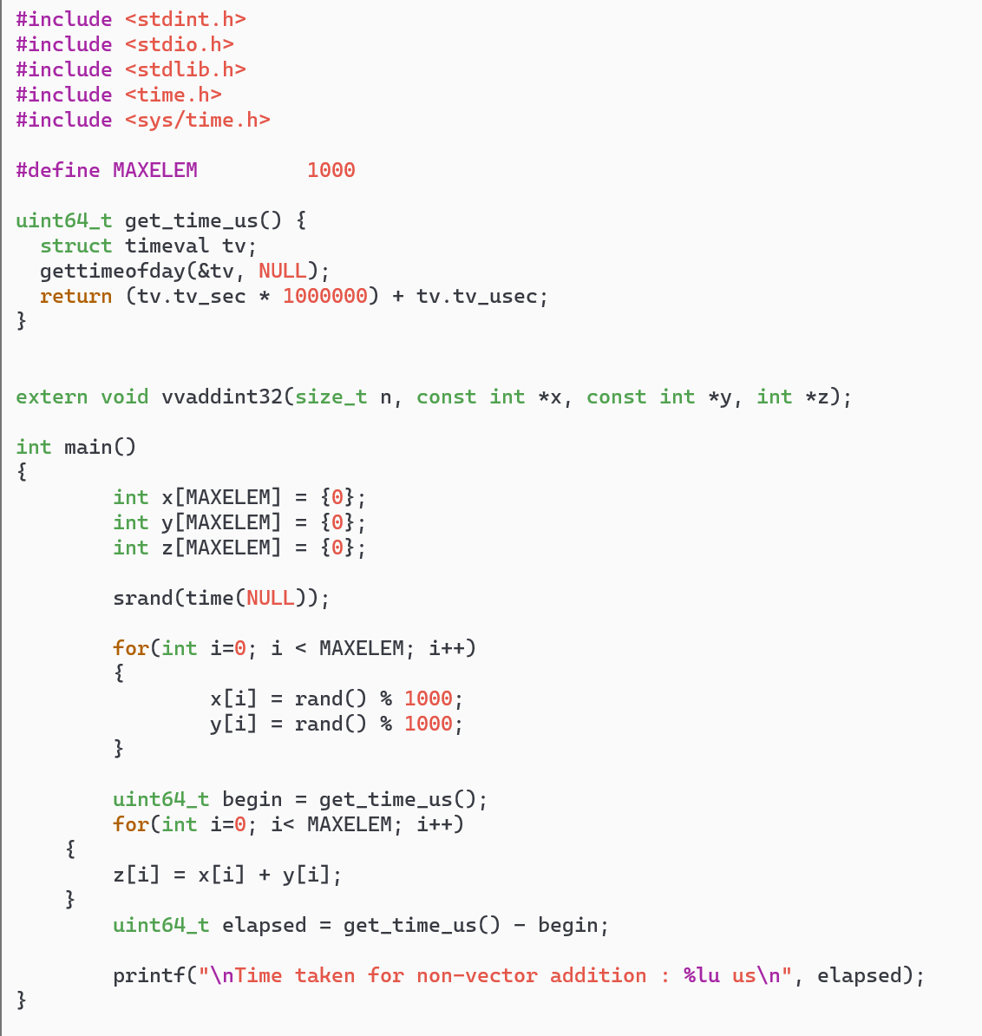
RISC-V SCALAR INSTRUCTION

Slide 22
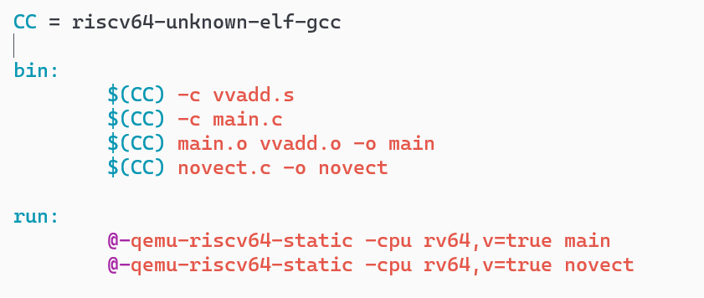
RISC-V MAKEFILE INSTRUCTION

Slide 23
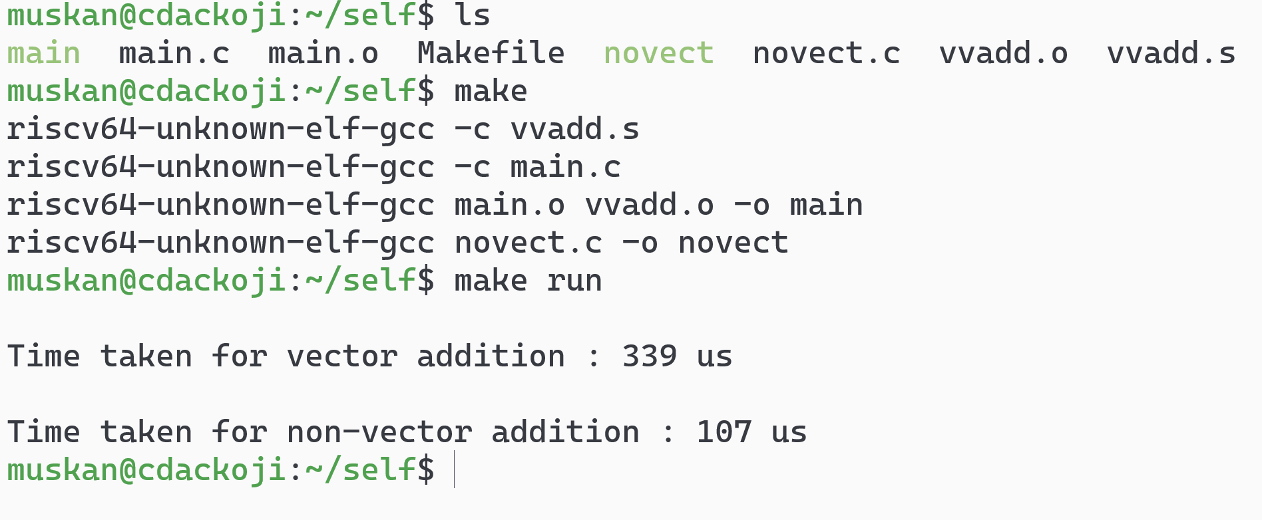
EXPLORING RISC-V VECTOR EXTENSION WITH QEMU

Slide 24
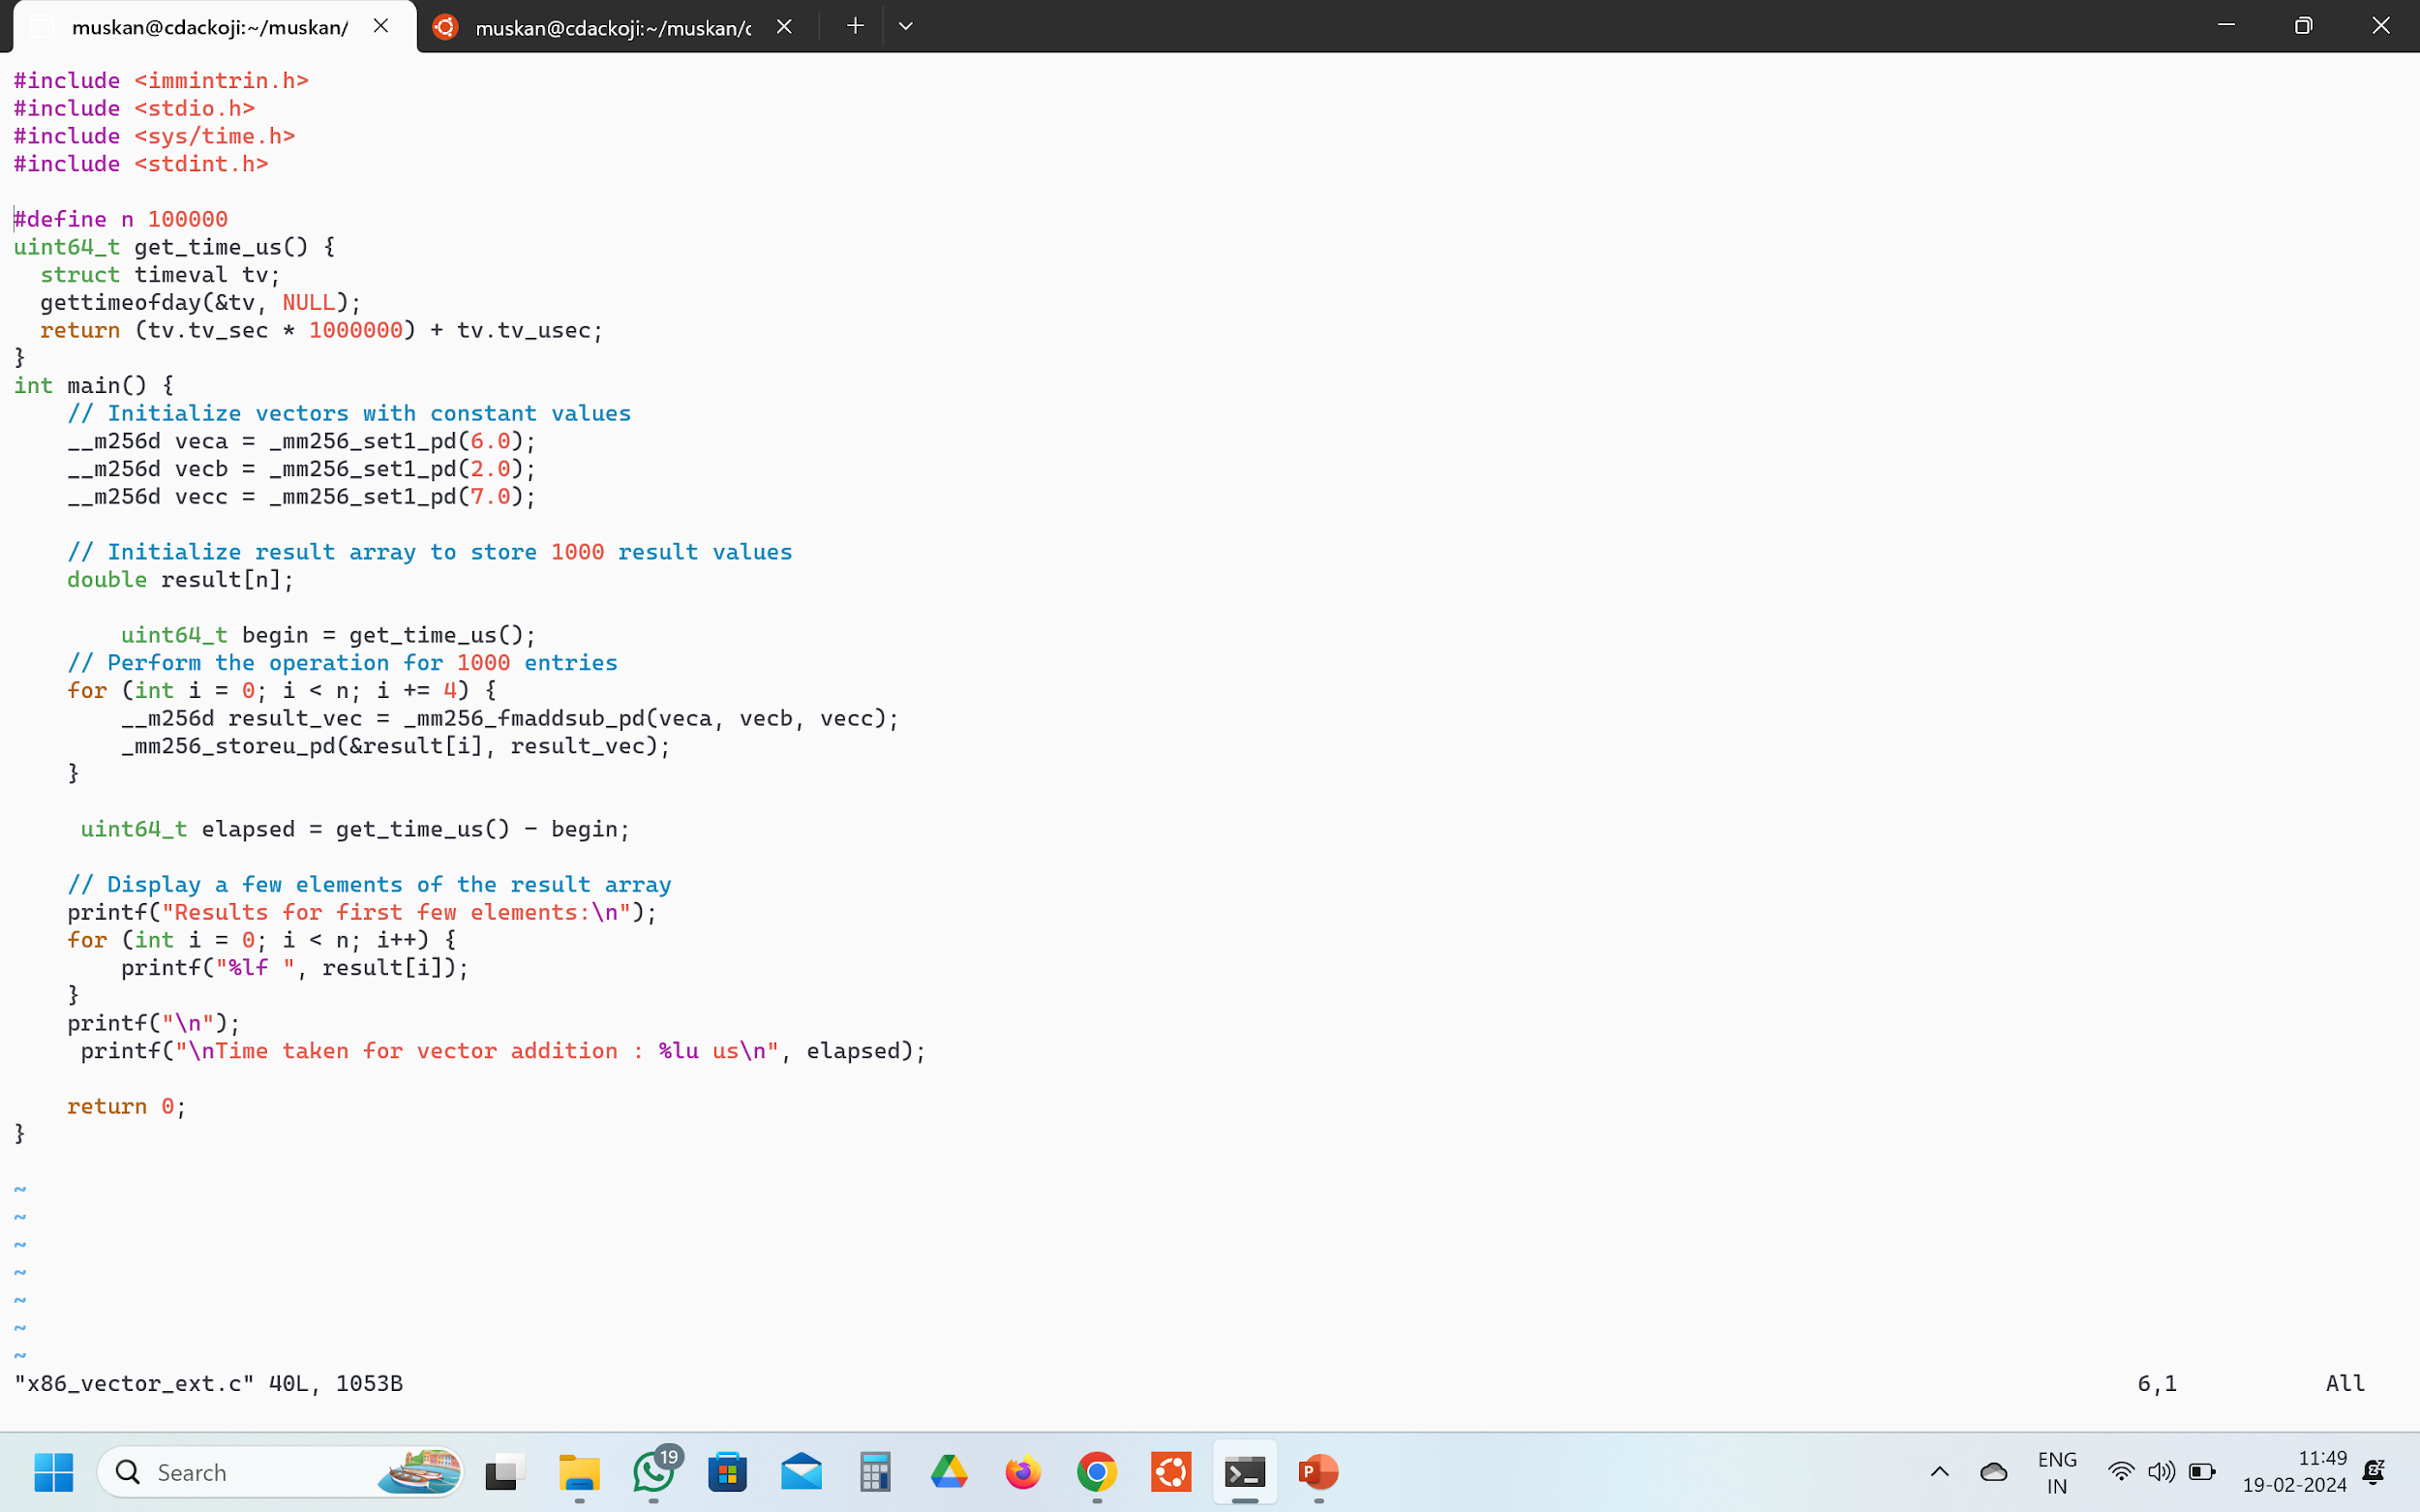
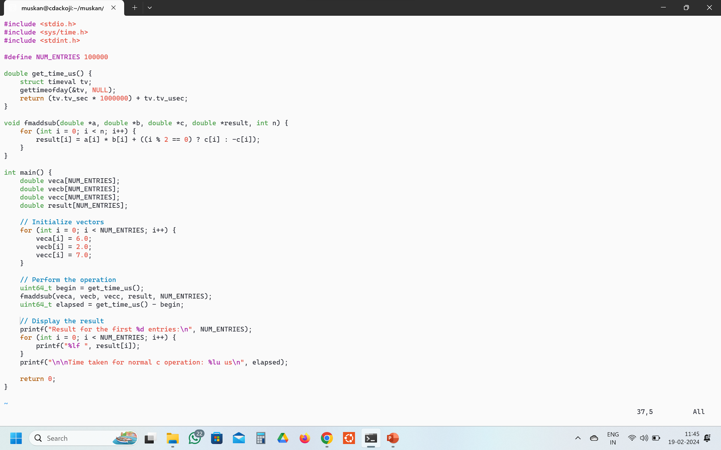
X_86 ARCHITECTURE
Vector Instruction
Scalar Instruction

Slide 25
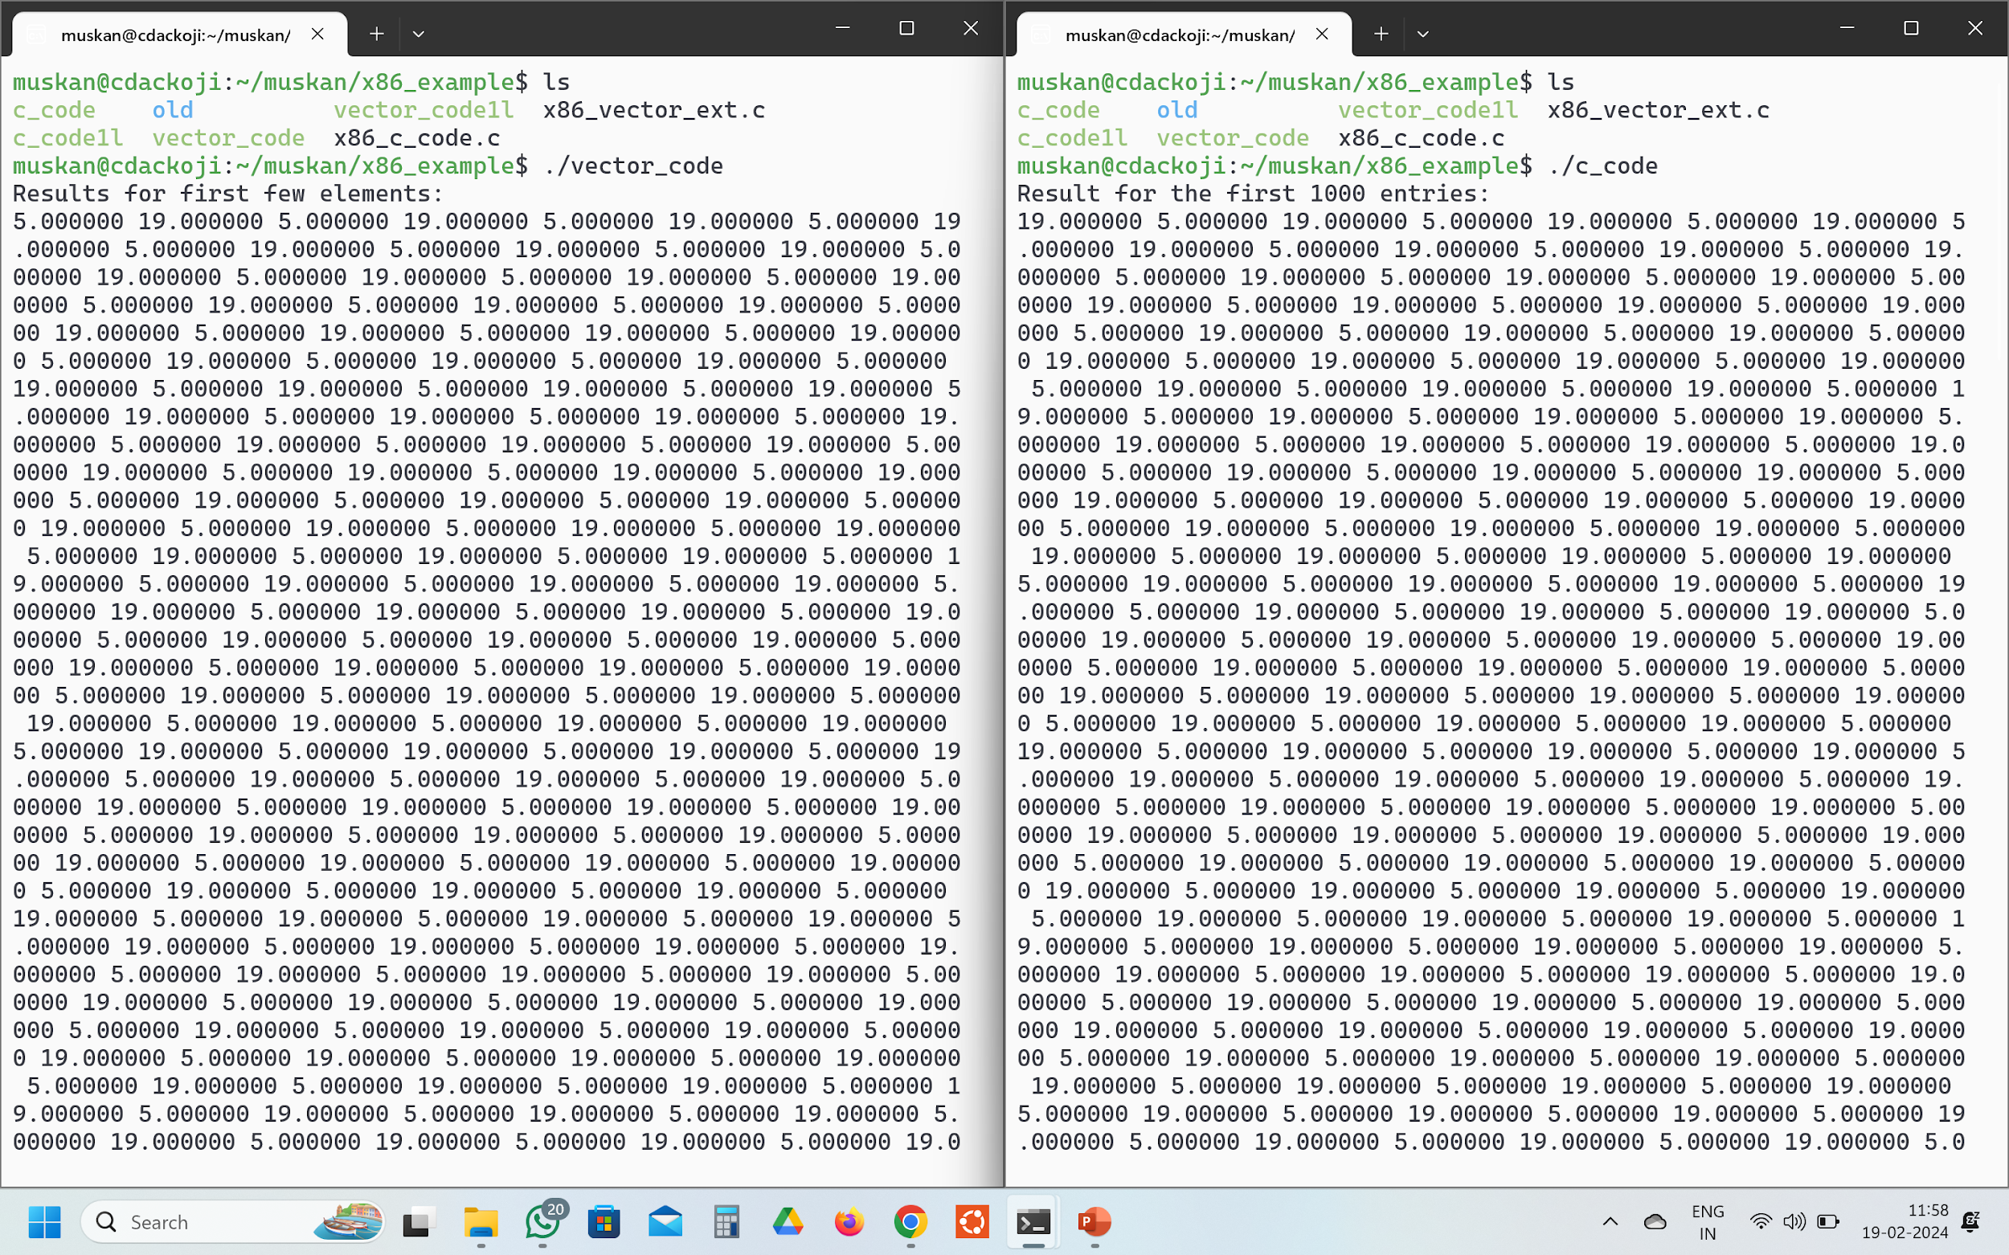
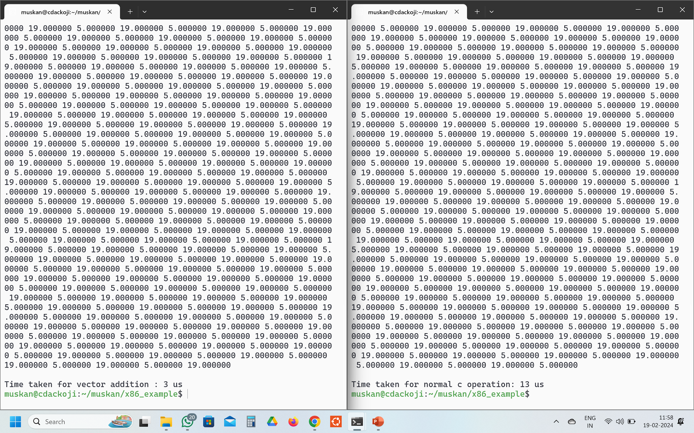
EXPLORING VECTOR EXTENSION WITH X_86 ARCHITECTURE

Slide 26
CHALLENGES AND LIMITATIONS
Programming Complexity: Utilizing vector instructions effectively requires specialized programming techniques such as loop unrolling, data alignment, and explicit vectorization, which can increase code complexity and development time.
Data Dependency: Dependencies among vector elements can limit parallelism and lead to inefficient utilization of vector resources, especially in algorithms with irregular data access patterns or conditional branching.
Memory Bandwidth: Vectorized operations can impose significant demands on memory bandwidth, especially for large vector lengths, leading to potential bottlenecks and inefficiencies in memory-bound applications.
Hardware Complexity: Implementing a high-performance vector unit entails additional hardware resources and complexity, including wider data paths, vector registers, and efficient memory access mechanisms, which may increase design complexity and power consumption.
Software Ecosystem: The availability of software tools, libraries, and compilers optimized for the Vector Extension may be limited compared to established architectures, posing challenges for developers in leveraging its full potential.

Slide 27
AREAS FOR IMPROVEMENT AND ONGOING RESEARCH
Compiler Optimization: Continued research is needed to develop advanced compiler techniques for automatic vectorization, loop restructuring, and optimization of memory access patterns to extract maximum parallelism from applications.
Vectorization Libraries: Further development of vectorization libraries and frameworks tailored for the Vector Extension can simplify programming and accelerate adoption by providing high-level abstractions and optimized routines for common tasks.
Memory Hierarchy: Research into efficient data prefetching, caching strategies, and memory hierarchy designs is crucial to mitigate the impact of memory bandwidth limitations and improve overall system performance.
Scalability and Heterogeneity: Investigating techniques for scalable vector processing across multiple cores and heterogeneous architectures, including integration with multi-core processors and accelerators, can enhance performance and flexibility in diverse computing environments.
Energy Efficiency: Optimizing vector architectures for energy efficiency through techniques such as dynamic voltage and frequency scaling, power gating, and instruction-level energy reduction is essential for enabling high-performance, energy-efficient computing systems.

Slide 28
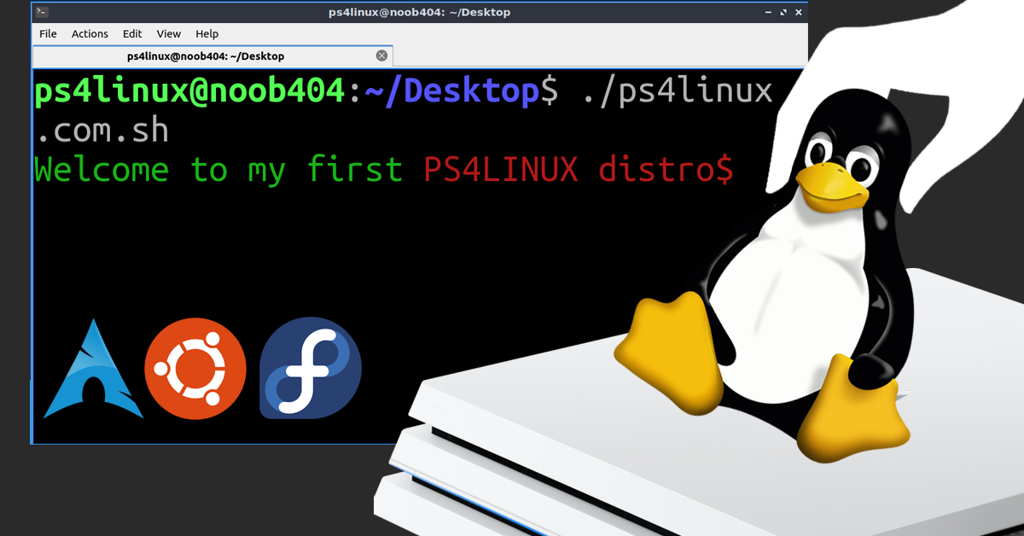

DIY LINUX – What?

Slide 29

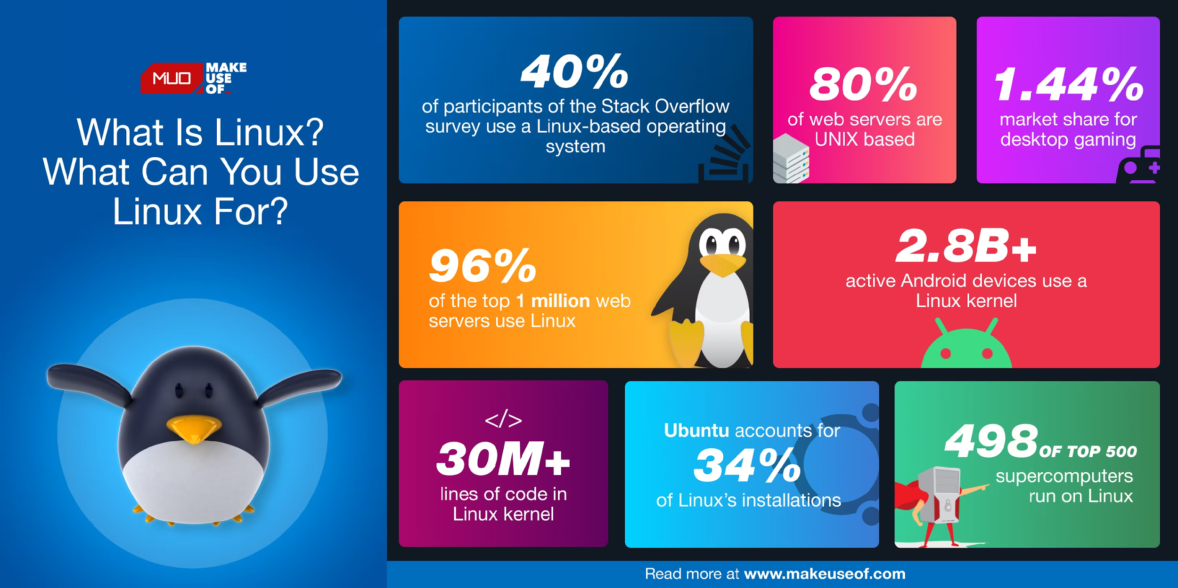
DIY LINUX – Why?

Slide 30
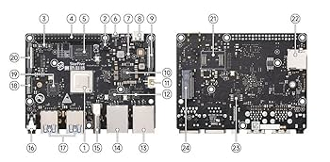
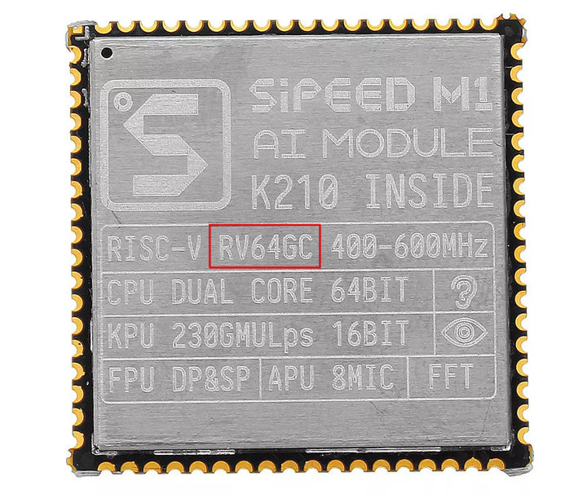
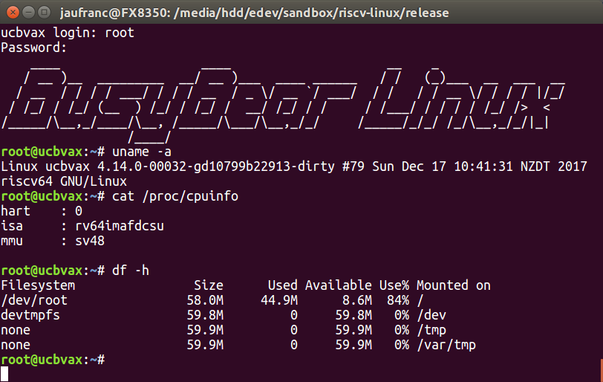
DIY LINUX – Where? – RVV (RISC-V Vector)
riscv64-gv (RV64GV)

Slide 31
DIY LINUX – How?
Configuring the Environment
Making cross Toolchain

Slide 32
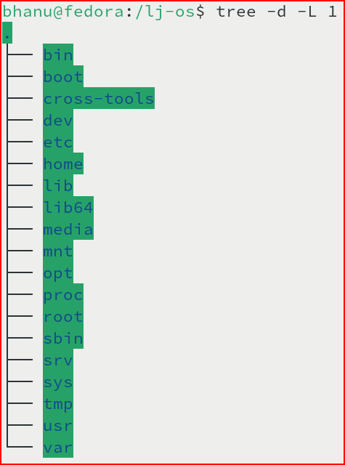
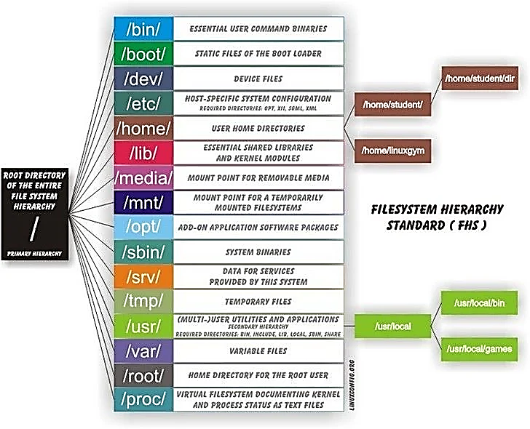
DIY LINUX – How?
Configuring the Environment

Slide 33
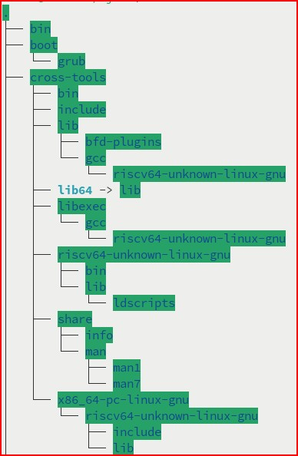
DIY LINUX – How?
Configuring the Environment
bin

Slide 34
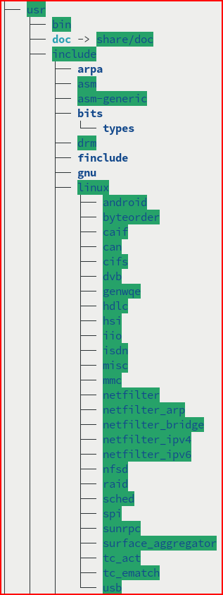
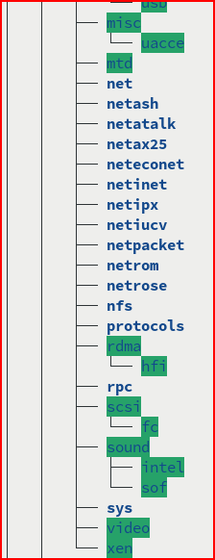
DIY LINUX – How?
Configuring the Environment
usr

Slide 35
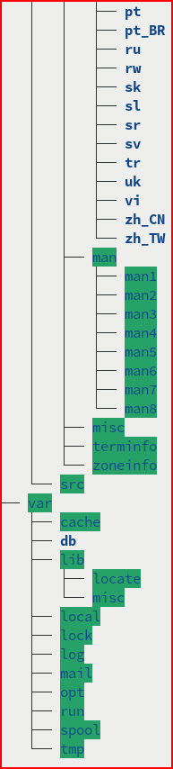
DIY LINUX – How?
Configuring the Environment
var

Slide 36
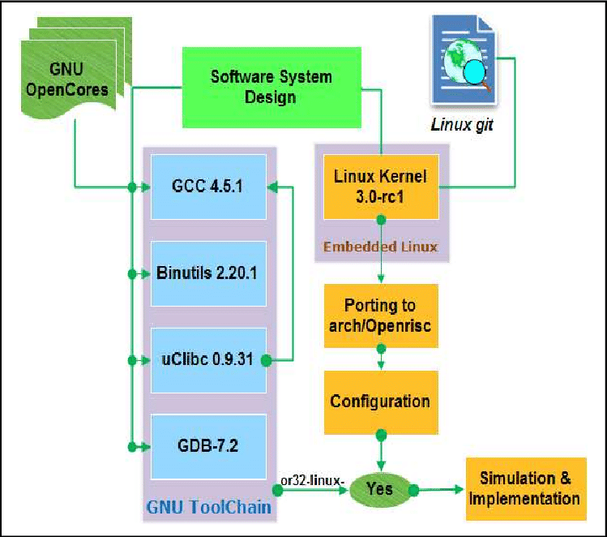
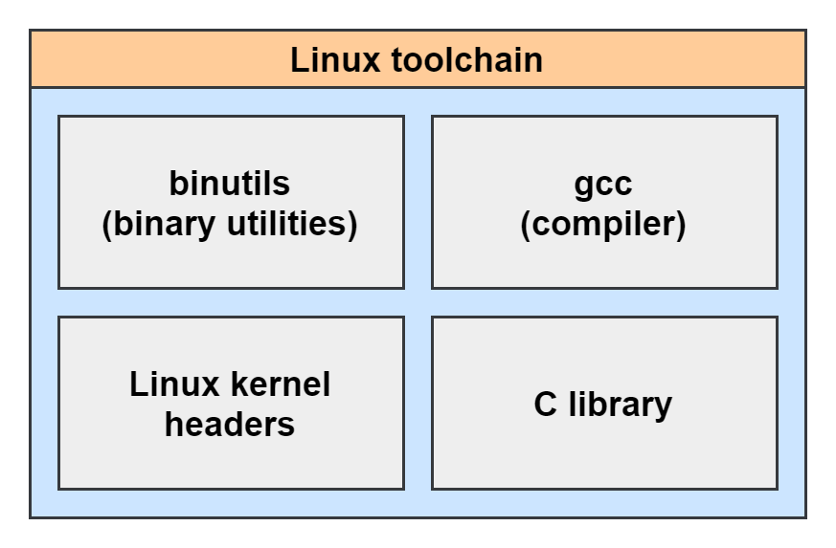
DIY LINUX – How? – Toolchain

Slide 37
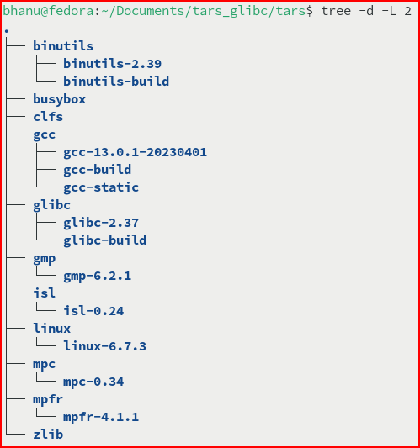
DIY LINUX – How? –
Toolchain

Slide 38
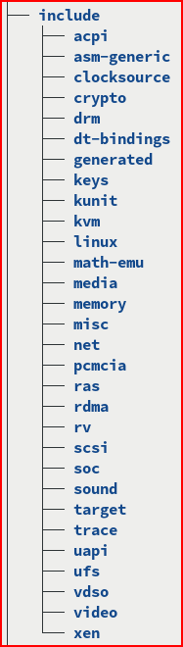
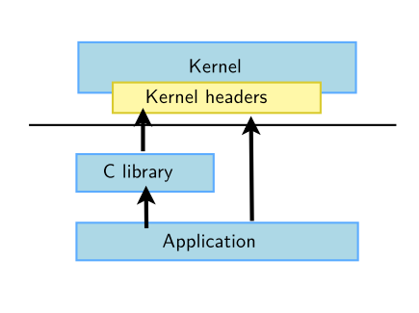
DIY LINUX – How? –
Kernel Headers - includes

Slide 39
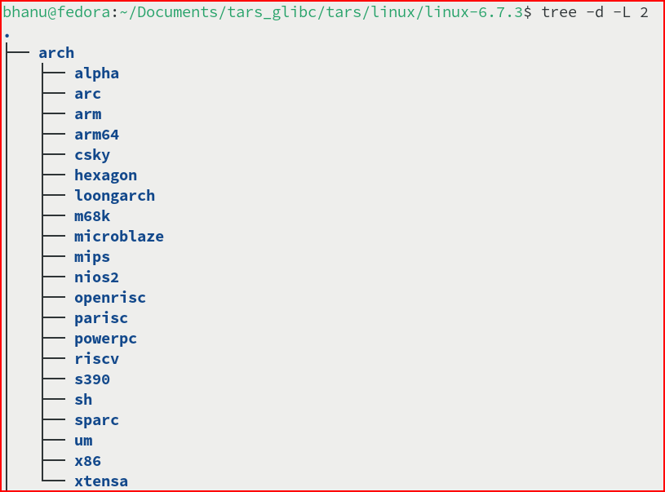
DIY LINUX – How? –
Kernel Headers – architecture dependent

Slide 40
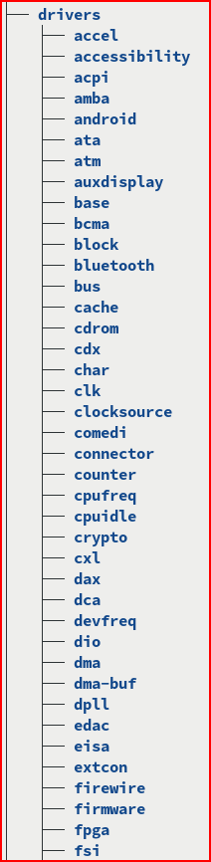
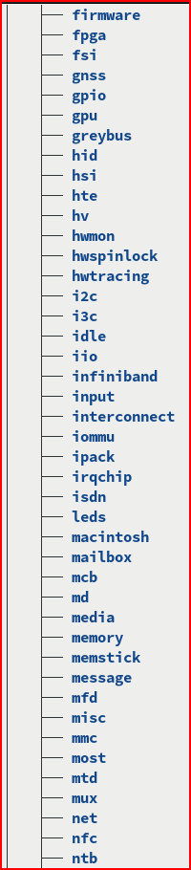
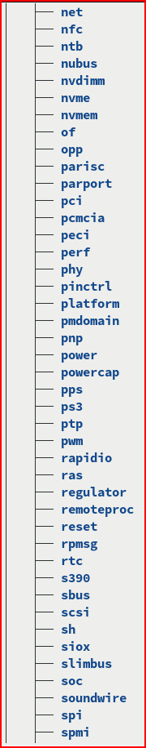
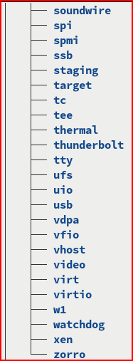
DIY LINUX – How? –
Kernel Headers - drivers

Slide 41
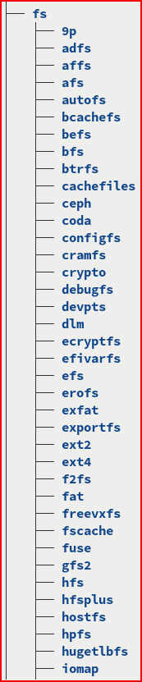
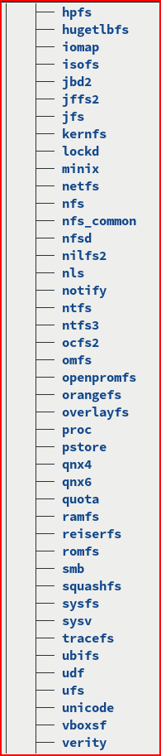
DIY LINUX – How? –
Kernel Headers – file system

Slide 42
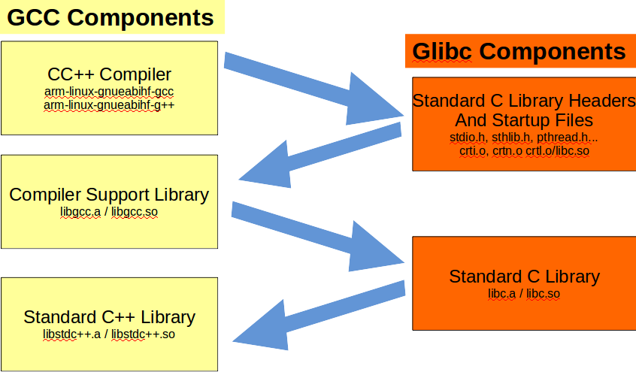
DIY LINUX – How?
Compiler

Slide 43
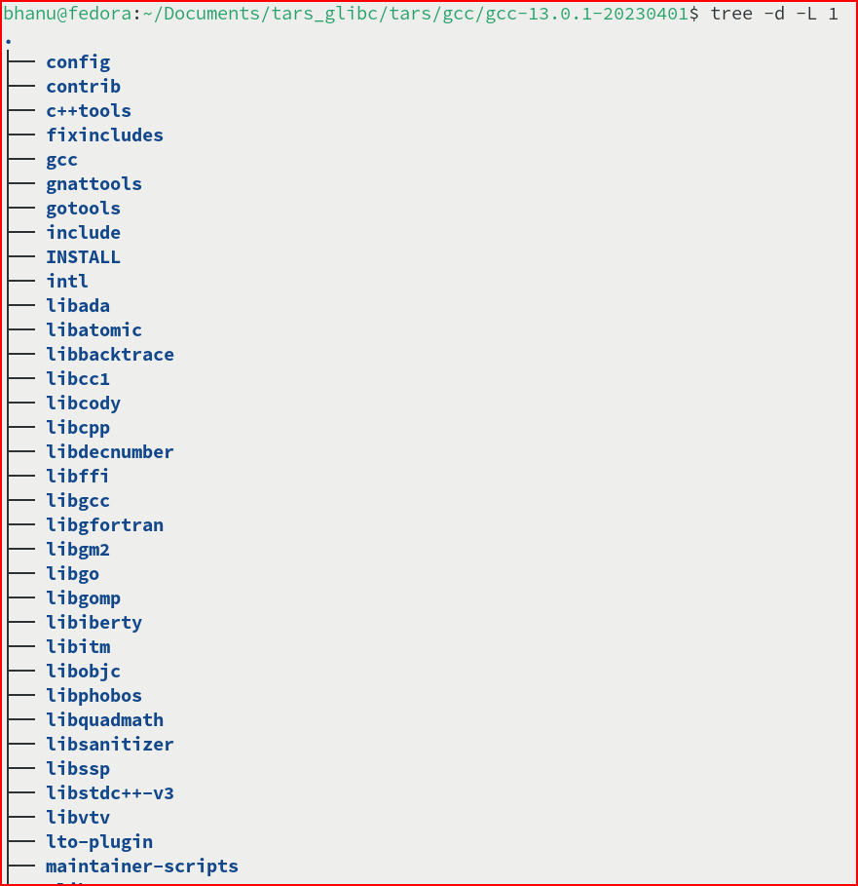
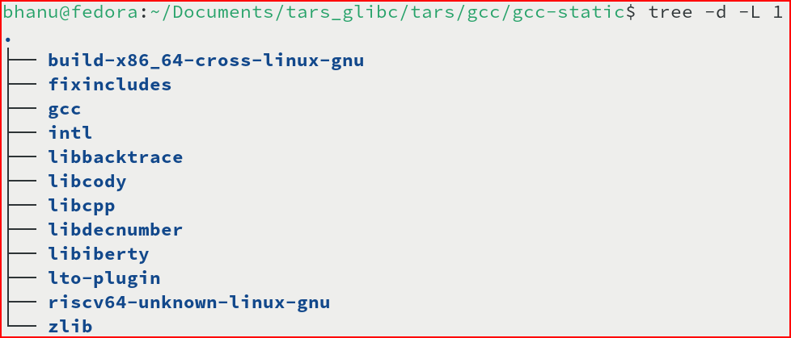
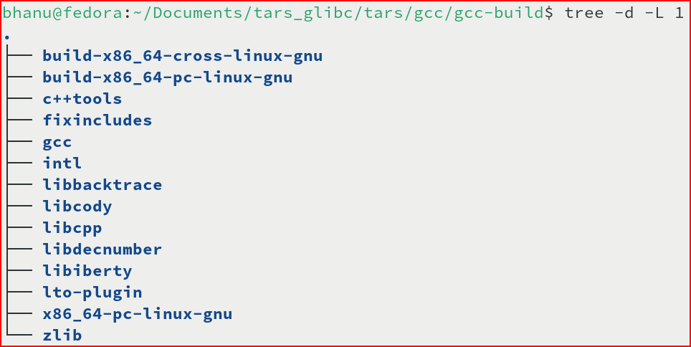
DIY LINUX – How?
Compiler –Resources to build compiler

Slide 44

DIY LINUX – How?
Cross-Compiler

Slide 45

DIY LINUX – How?
Cross-Compiler - build

Slide 46


DIY LINUX – How?
Cross-Compiler - contains

Slide 47

DIY LINUX – How?
Cross-Compiler executable test

Slide 48

DIY LINUX – How?
Cross-Compiler - Application

Slide 49
THANK YOU !

